Slide 1
A Simple Communication Scenario
Traditional and in a SDN like fashion.

Slide 2
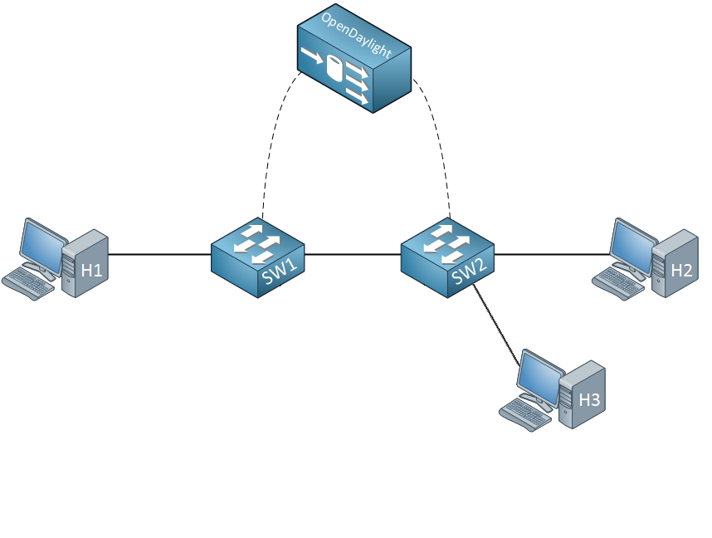
Communication WITHOUT controller
Let’s say “Hi” to H2!
Notes:
We can visualize the difference in the way the communication goes in the following examples [following 2 slides included].
First we start in the case that there is no controller, which leaves us with ‘smart’ forwarding devices which communicate with each other.

Slide 3
Communication WITHOUT controller
Let’s say “Hi” to H2!
I don’t know either!
I don’t know H2, let’s just ask all my ‘friends’
Notes:
[Follow the image ☺]

Slide 4
Communication WITHOUT controller
Better do I remember this for next time!
H2, that is me! Did I win something?
Nope, that is not me; Better shut it.
Notes:
[Follow the image]
Note that communication between the switches isn’t necessary the next time for communication between H1 and H2, as the switches can leverage cached information.

Slide 5
Communication WITH controller
Let’s say “Hi” to H2
I don’t know what to do, better get some help!
Notes:
So now we are going to see how communication with the use of a controller works. [Following 3 slides included]
In this case, switches are ‘simple’ and can only leverage information in their so-called Flow Table. In this case, we start with only entry – ‘contact the controller if you don’t find a match’
In SDN, one can implement the behavior of the controller (and thus of the network) as he/she likes. We could for example say that at ‘startup time’ all connection information is shared with the controller such that he finds the topology and directly adds flows to the different flow tables. We could also hardcode the flows into the Flow Tables.
In this case, we want the controller to direct a ‘learning switch’ network, such as we had without the controller.

Slide 6
Communication WITH controller
Just FLOOD it (I am still collecting information)
PACKET_IN
PACKET_OUT
OK, just do as you’re told…
Notes:
[Follow the image ☺]

Slide 7
Communication WITH controller
Save this in your Flow Table, then you know what to do!
FLOW_ADD
H2, that is me! Did I win now?
PACKET_IN
My Flow Table is still empty…
Notes:
[Follow the image ☺]

Slide 8
Communication WITH controller
Let’s say “Hi” again!
My Flow Table is up to date!
Notes:
[Follow the image ☺]
After this, we end up with the following Flow Table for switch 1. In a next conversation between H1 and H2, we don’t need to contact the controller.
But it could be the case that Flows are ‘deleted’ from the Flow Table – it is possible to give flows a hard or soft timeout.
In fact a lot of cool stuff could be done in this example (like using the ‘group table’ which allows you to define more actions per ‘match’ to copy all packets to H3), but that is out of the scope of this talk ☺

